Slide 1
DATA VISUALIZATION ON LANDMARK ISSUES
WEB/MOBILE PROGRAMMING
Navya gonuguntla
MADHURI SARDA
JAYAPRAKASH RAVELLA

Slide 2
Content
Introduction
Platform/Tools/Languages involved
Visualizations

Slide 3
Landmark Issues?
There are a set of rules that each construction should abide by.
These are a set of rules that differ from a city to city
If these rules are broken, then it is called a violation.
There can be a series of landmark violations ranging from burglary, robbery, trespassing etc.

Slide 4
Platform/Tools/Languages involved
HTML, CSS
JavaScript, AngularJS
Microsoft Visual Studio Code IDE

Slide 5
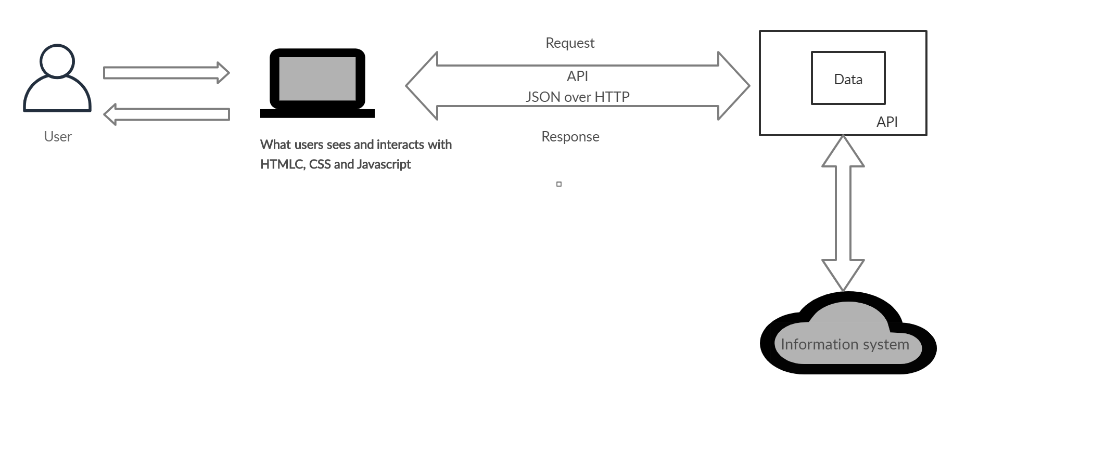
SYSTEM ARCHITECTURE

Slide 6
Datasets Used
The following datasets are being used for making API calls,
Census agency has demographic survey of United States citizens from 2010 to 2019. It is American Community Survey dataset. It contains the needed demographic information such as race, age and gender of people living locality wise (zipcode wise).
https://www.census.gov/data/developers/data-sets/acs1year.html
Data.gov is the federal government’s open data site. We are using information provided by this website to fetch data.
https://www.data.gov/open-gov/

Slide 7
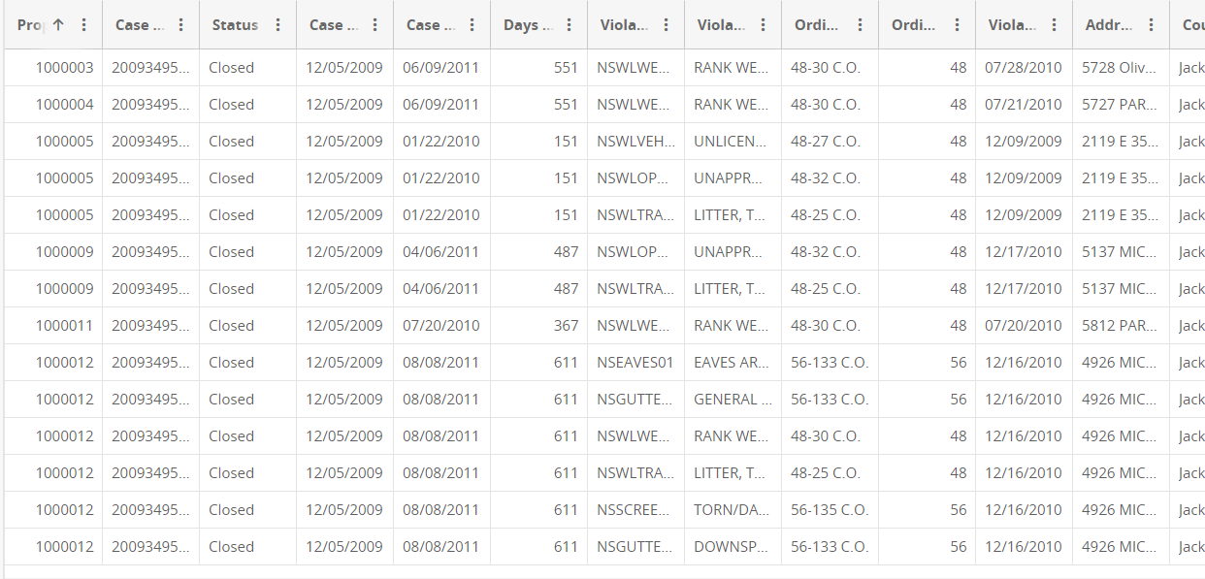
Sample Data

Slide 8
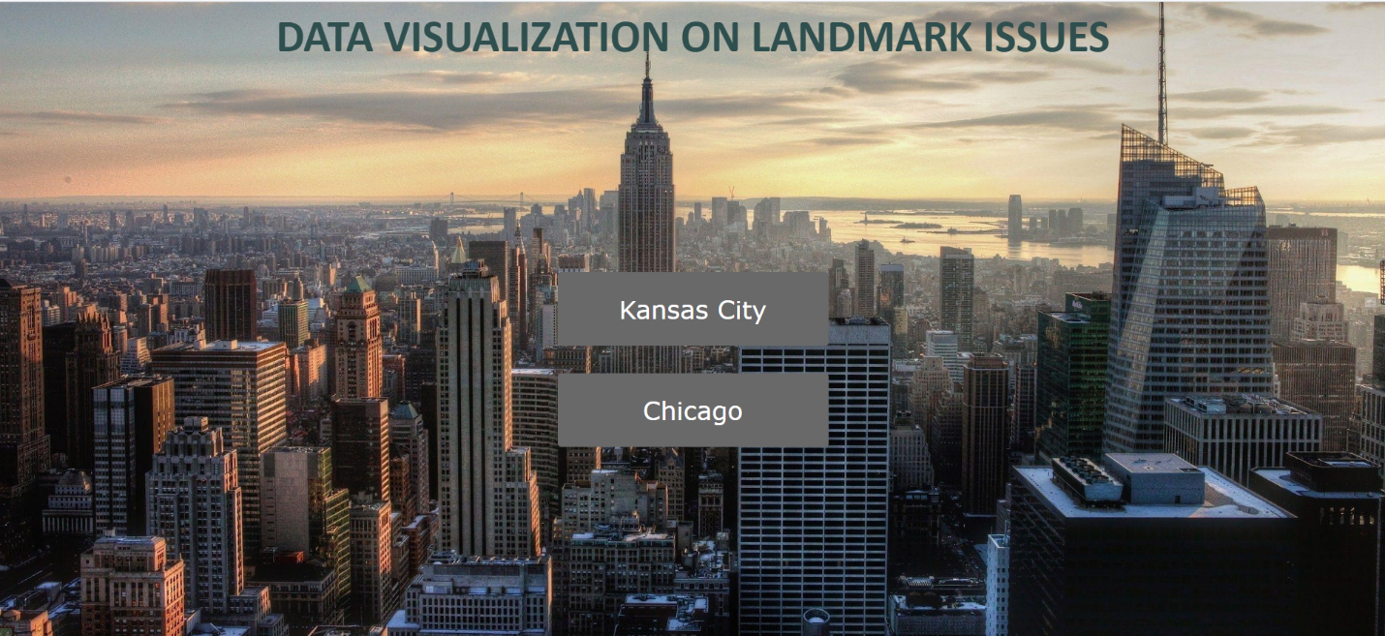
Homepage

Slide 9
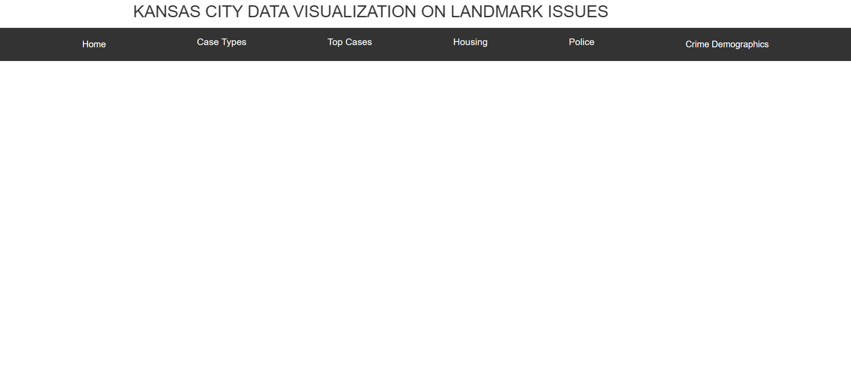
Homepage (Cont)
There are two buttons designed. Clicking on the city’s name would redirect to a new page that displays a series of valuable and useful information.

Slide 10
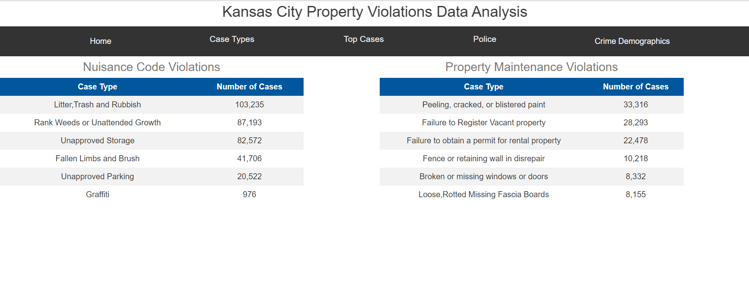
Types of landmark violations in KC
Landmark violations are divided into two different categories
Nuisance Code Violations
Property Maintenance Violations

Slide 11
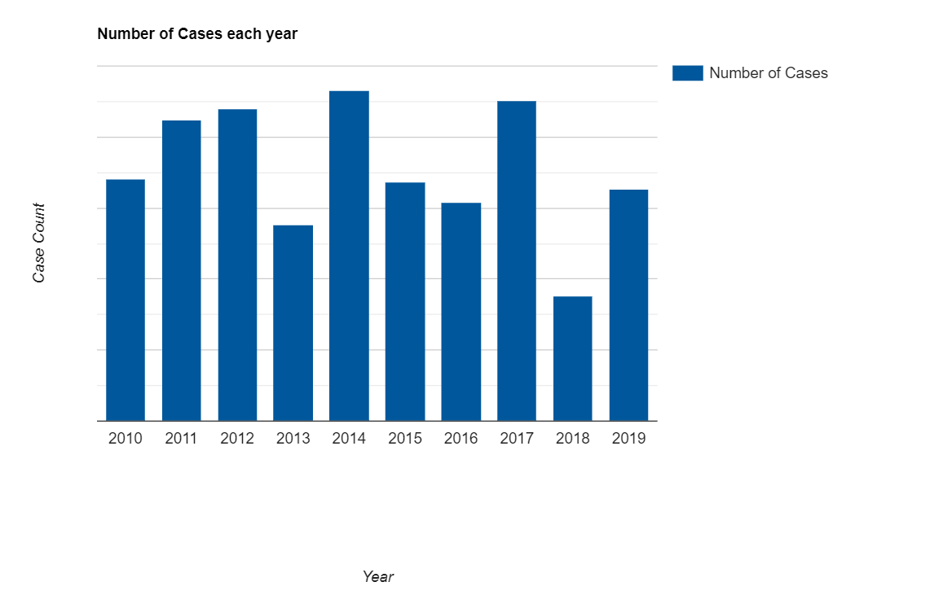
Number of cases filed from 2010 to 2019
The graph shows the number of cases files over the decade

Slide 12
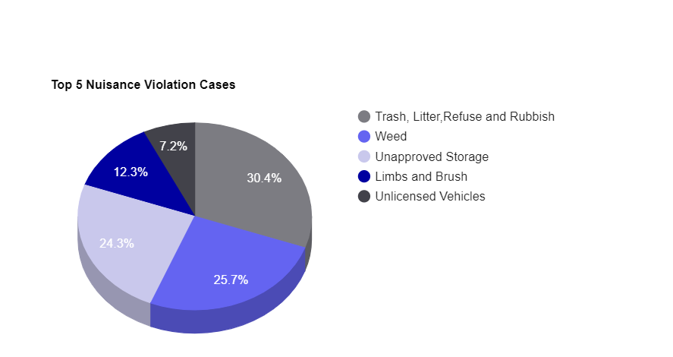
Top 5 nuisance violation cases
Top 5 nuisance cases are as follows

Slide 13
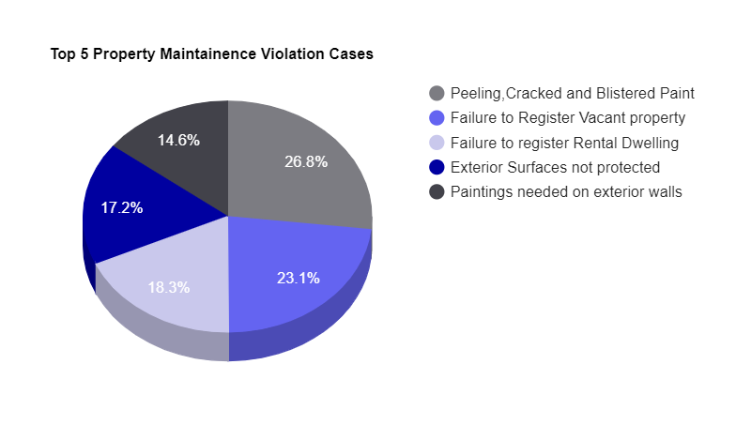
Top 5 property maintenance violation cases
The following are the top 5 maintenance violation cases.

Slide 14
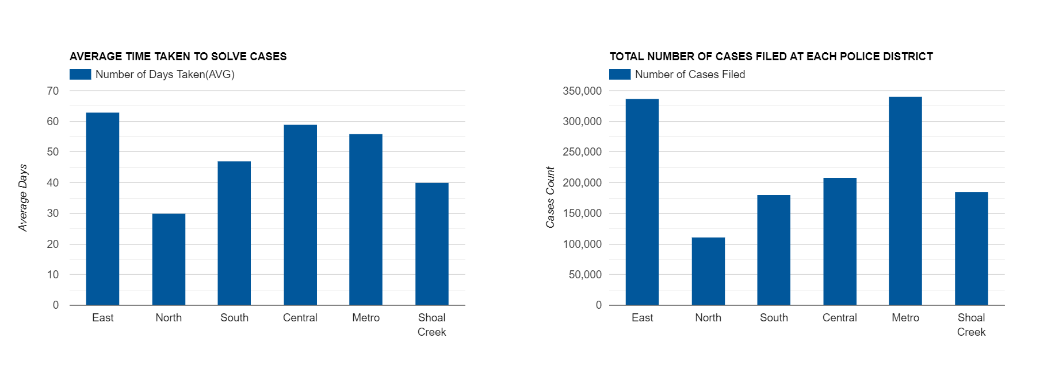
Police Jurisdiction analysis
The graphs beside show how each police district are working.

Slide 15
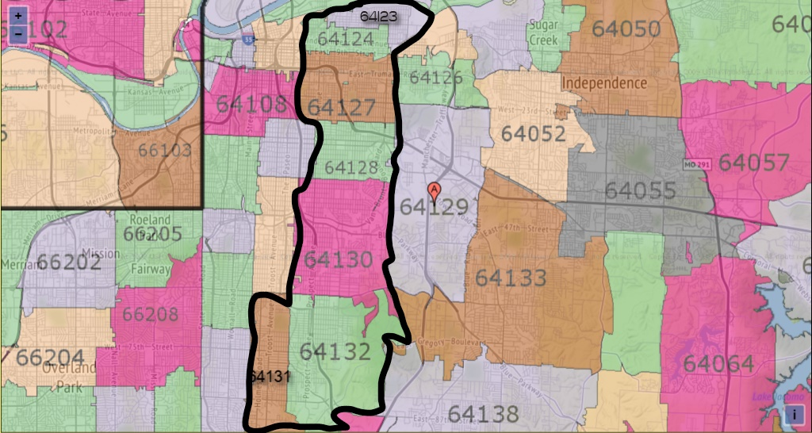
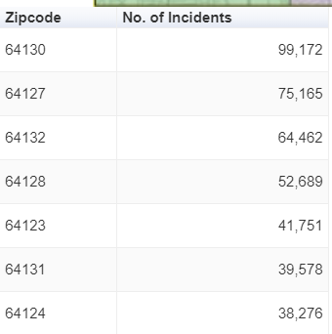
Top zip codes
It is clear from the below hand drawn diagram that all the zipcoded areas where violations takes place the most are the ones that lies next to one another and right next to troost avenue.

Slide 16
DEMOGRAPHICS OF CRIMES (LANDMARKS)
The following demographics are considered for analyzing the data,
Gender
Race
Firearm usage

Slide 17
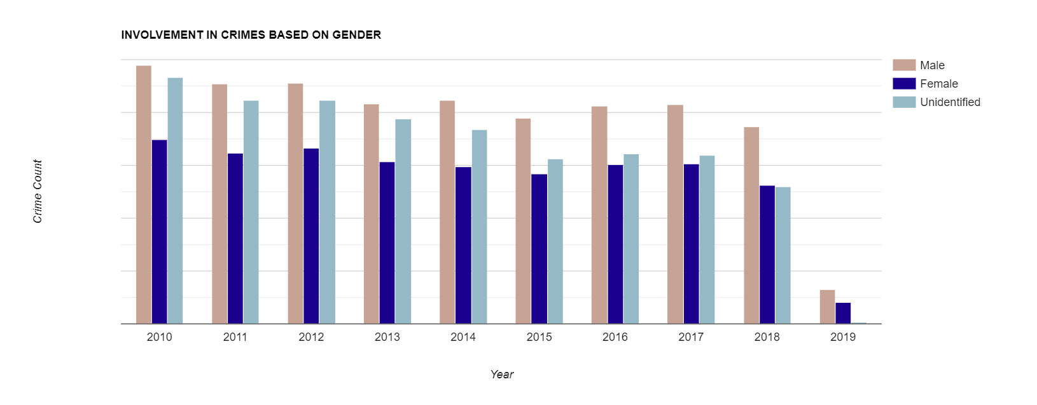
Involvement in crimes based on gender
It can be seen from the below graph that over the decade, involvement of males in committing these crimes is high that the other gender.

Slide 18
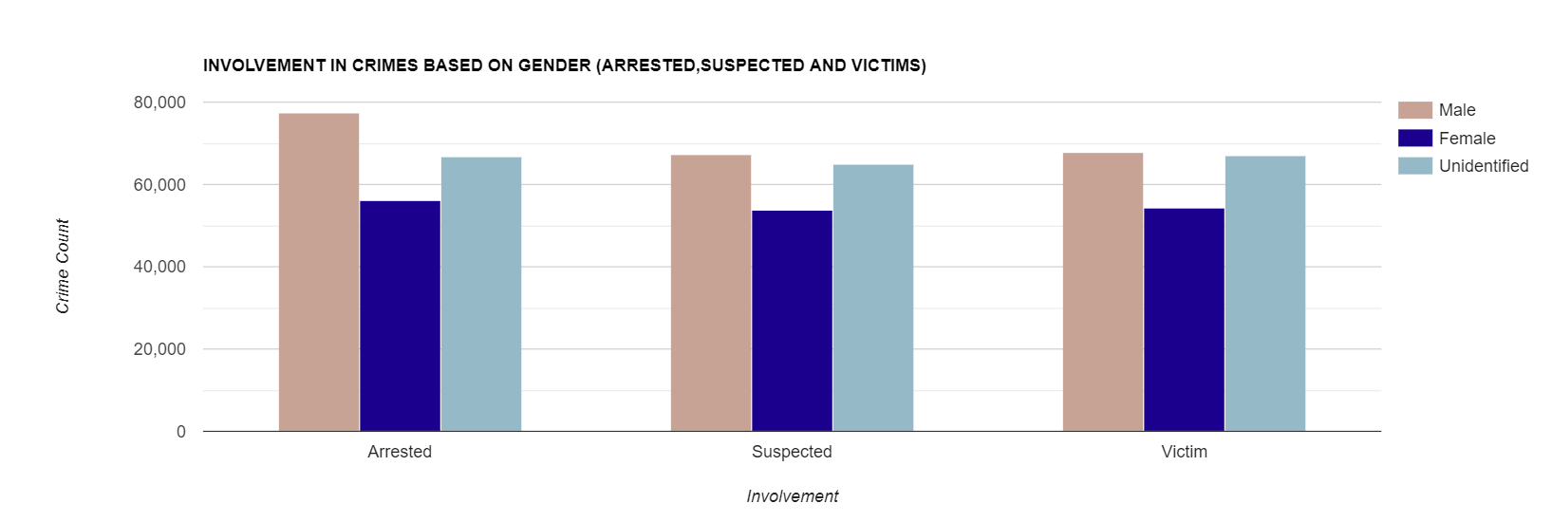
Involvement in crimes based on gender (Cont.)
It can be seen from the below graph that over the decade, involvement of males in committing these crimes is high that the other gender.

Slide 19
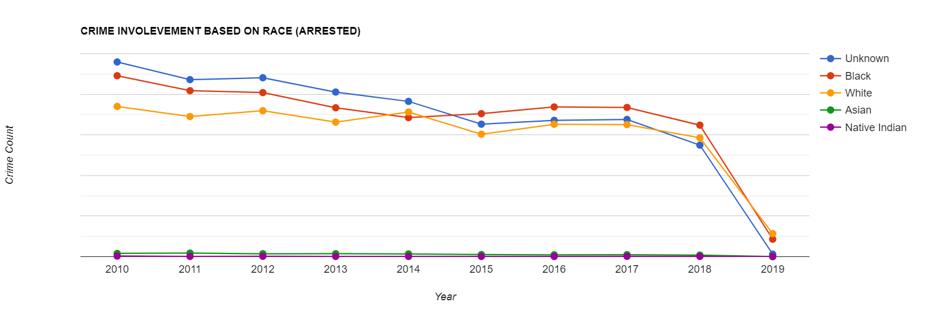
Involvement in crimes based on race
From the below graph, interesting analysis has been drawn. Although involvement of people of color is high over the years their involvement has been decreasing over the years as opposed to certain preconceived notions.

Slide 20
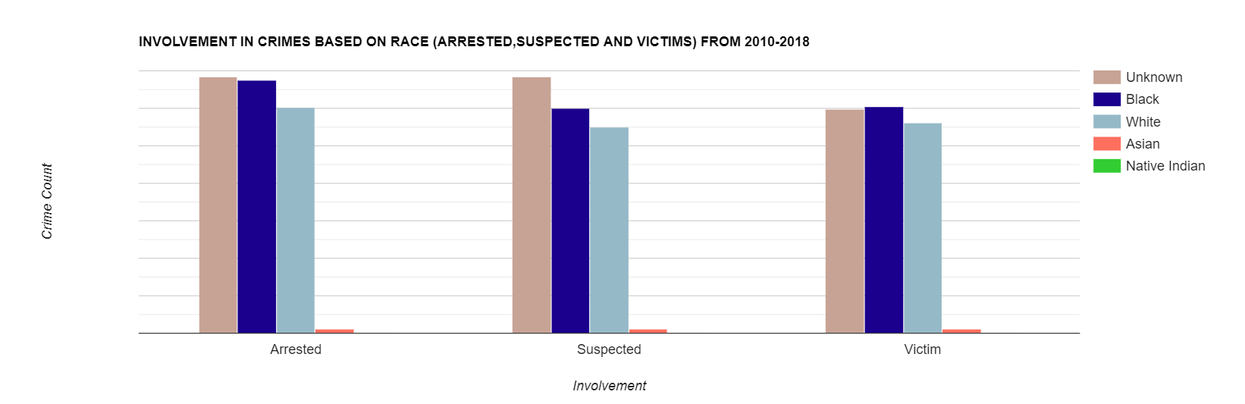
Involvement in crimes based on race (Cont.)
Unknown category tops the most in all three categories (arrested, suspected and victims) followed by Black category. Opposing conventional opinions, Black victims are high compared to white and other races.

Slide 21
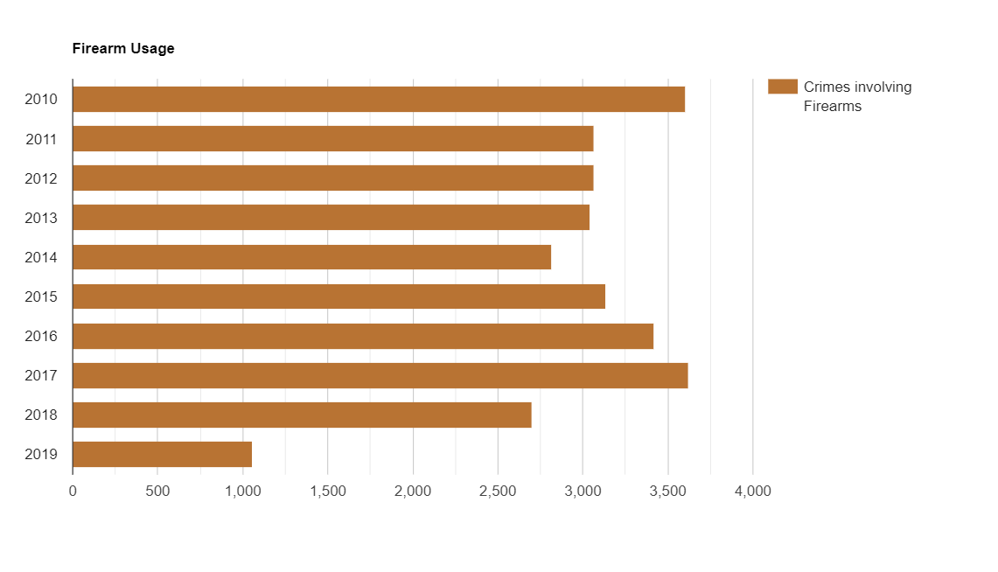
Firearm usage
The firearm usage has been analyzed in committing these violations (armed robbery). A fluctuation in the usage of firearms can be seen over the decade.

Slide 22
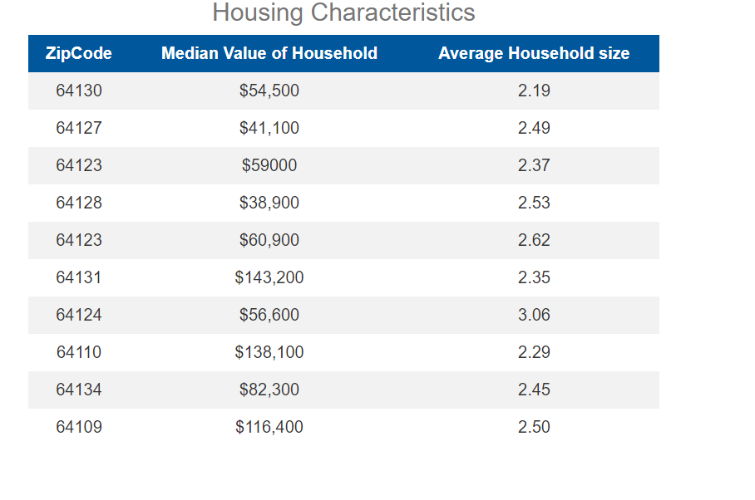
Housing Characteristics
The following is the tabular representation of the median value of household and average household size.

Slide 23
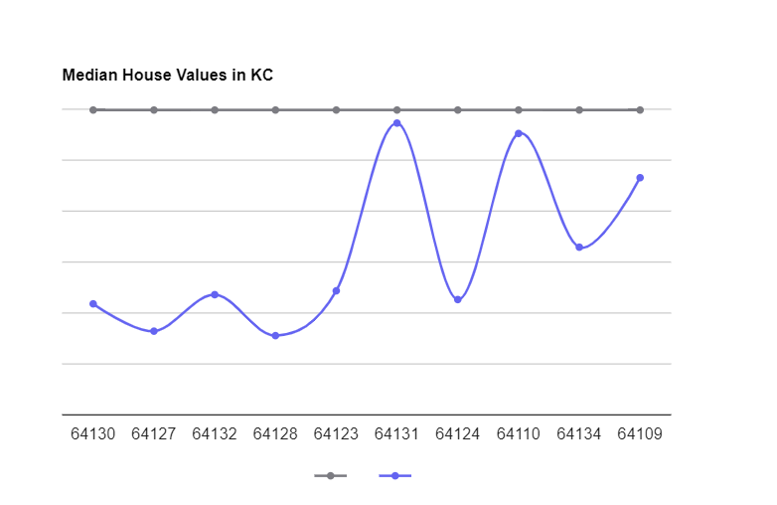
Housing Characteristics
It can be clearly seen that the areas where landmark crimes are reported the most are the places that lies below the median house value in KC.

Slide 24
NEW YORK CITY LANDMARK ISSUES DATA VISUALIZATIONS

Slide 25
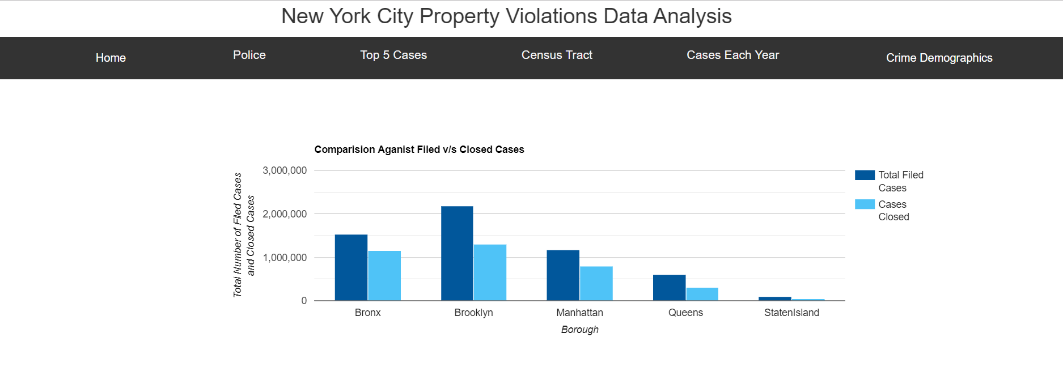
NYC DATA ANALYSIS
In NYC, Brooklyn is the place with a large number of filed cases.

Slide 26
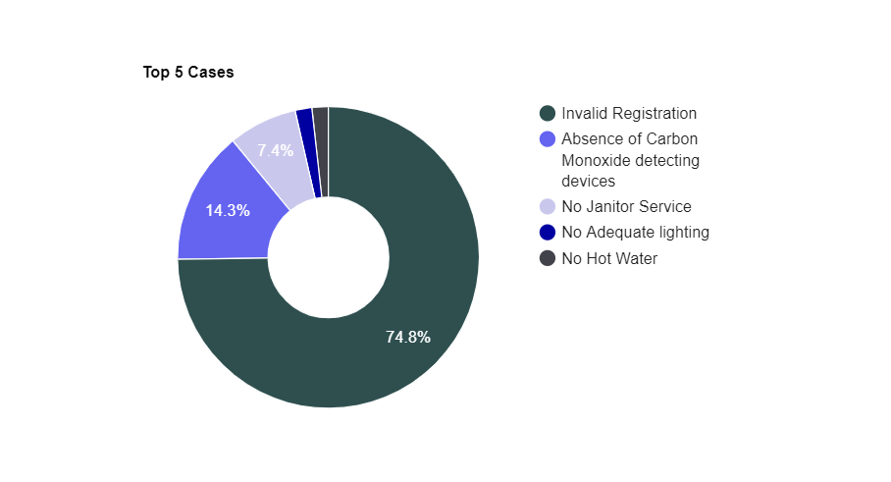
NYC DATA ANALYSIS
Top 5 violation cases filed in NYC are as follows:
Invalid Registration
Absence of Carbon Monoxide detecting devices
No Janitor Service
No Adequate lighting
No hot water
Invalid registration tops the most with 74.8% of total property violation cases.

Slide 27
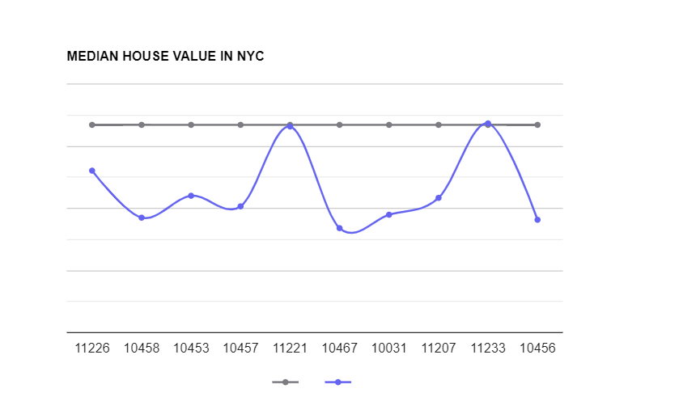
NYC DATA ANALYSIS
The same results have been found in NYC just as in KC.

Slide 28
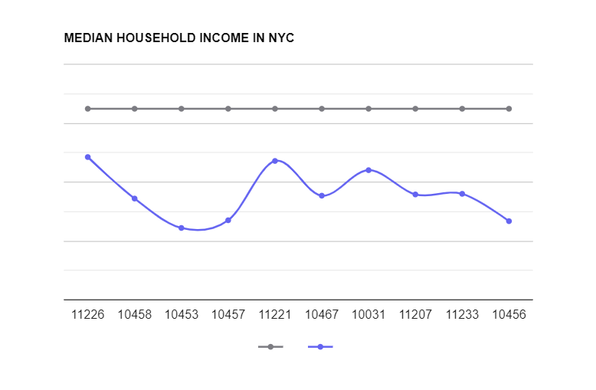
NYC DATA ANALYSIS
The same has been observed in NYC WRT Median household income.

Slide 29
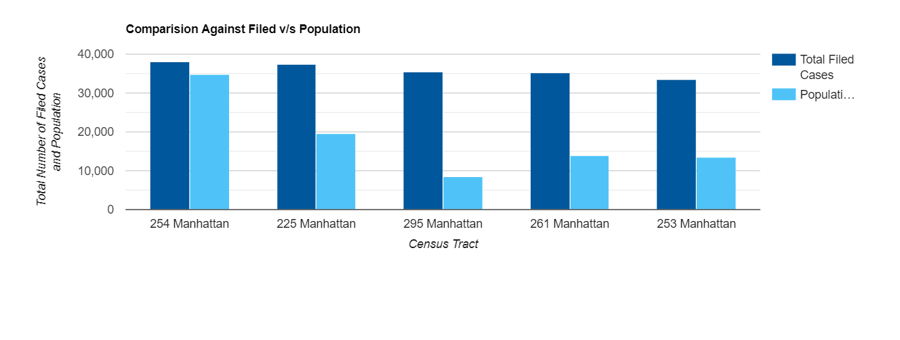
NYC DATA ANALYSIS
Top 5 tracts where violations takes place the most.

Slide 30
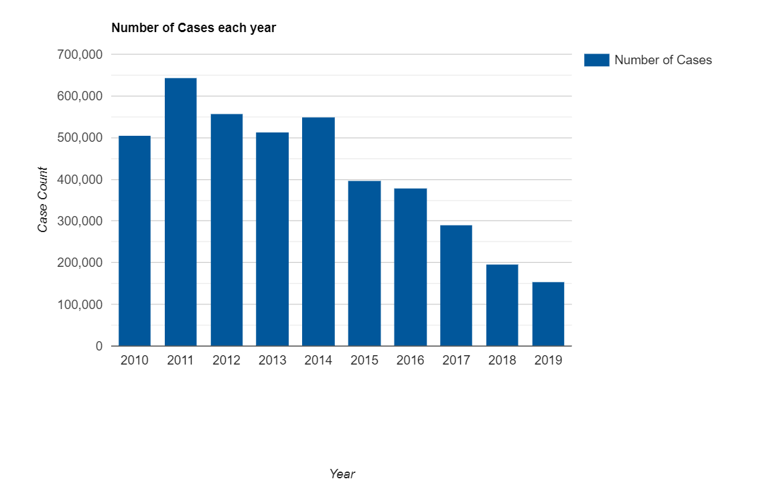
NYC DATA ANALYSIS
The total number of cases filed over the years from 2010 till 2019.

Slide 31
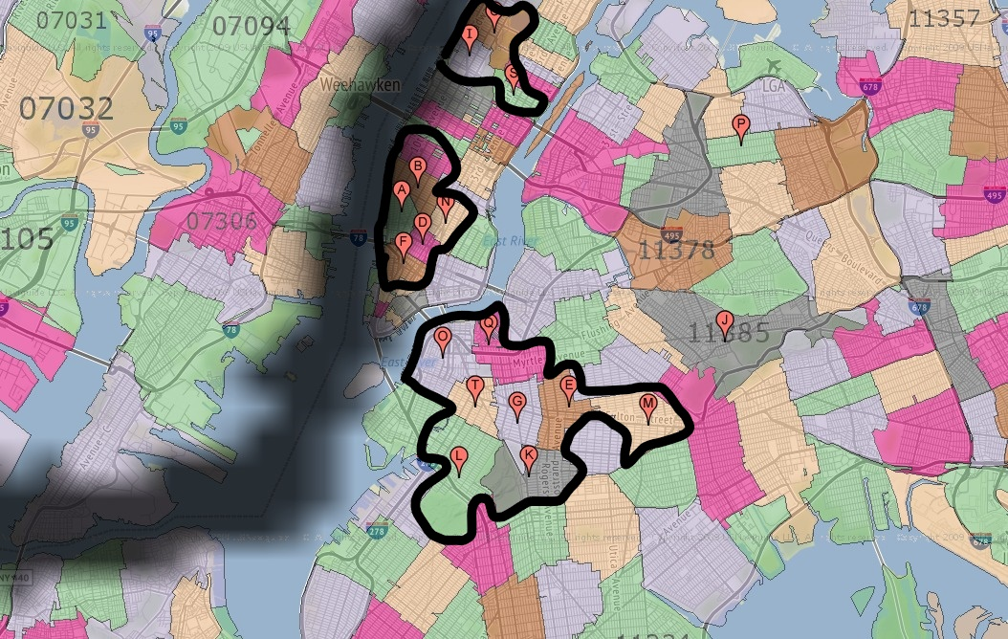
NYC DATA ANALYSIS
Contagious behavior has been observed in NYC. The pins are top zip-codes where cases are filed the most.

Slide 32
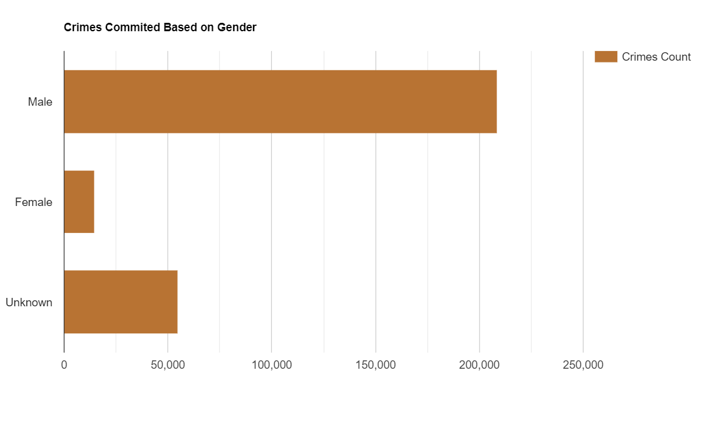
NYC DATA ANALYSIS
Involvement of men in crimes in NYC is far higher than that of women living in NYC.

Slide 33
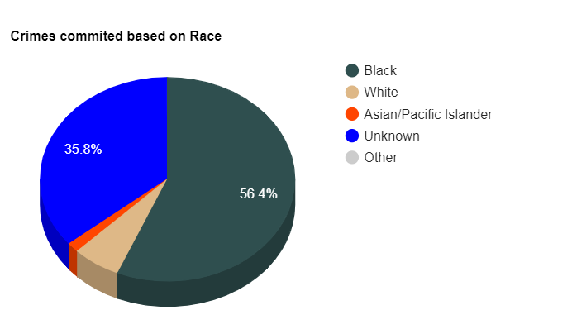
NYC DATA ANALYSIS
56.4%(Nearly half) involved in landmark issues are people of color.

Slide 34
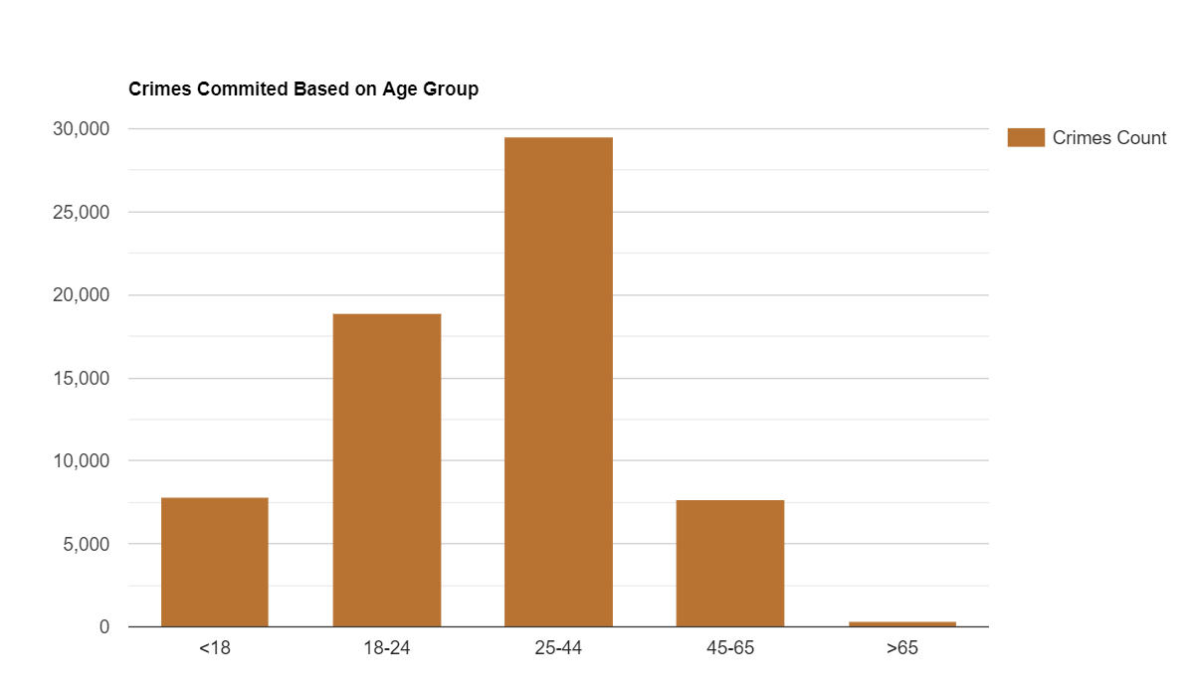
NYC DATA ANALYSIS
Crimes committed by adults is quite high compared to other age groups.

Slide 35
CHICAGO LANDMARK ISSUES DATA ANALYSIS

Slide 36
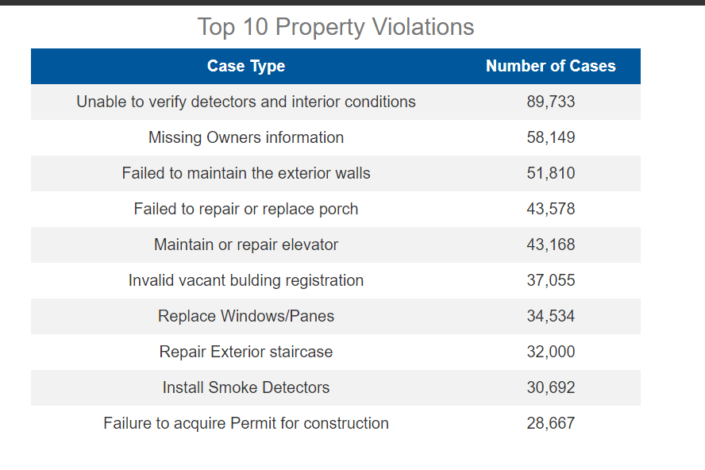
CHICAGO DATA ANALYSIS
A tabular representation of top 10 property violation cases all over Chicago.

Slide 37
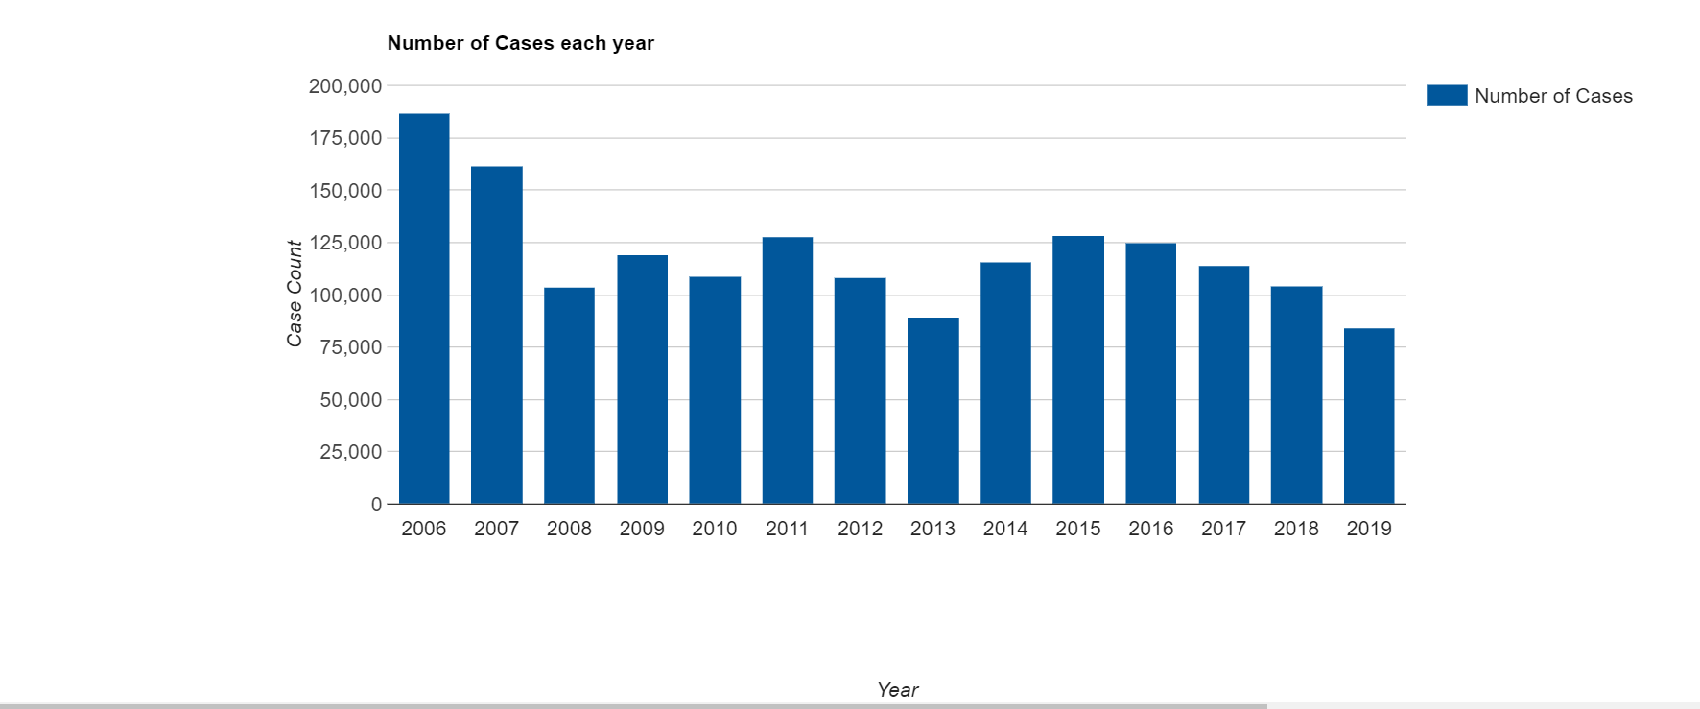
CHICAGO DATA ANALYSIS
A graph showing the number of cases filed over the years (from 2006 to 2019).

Slide 38
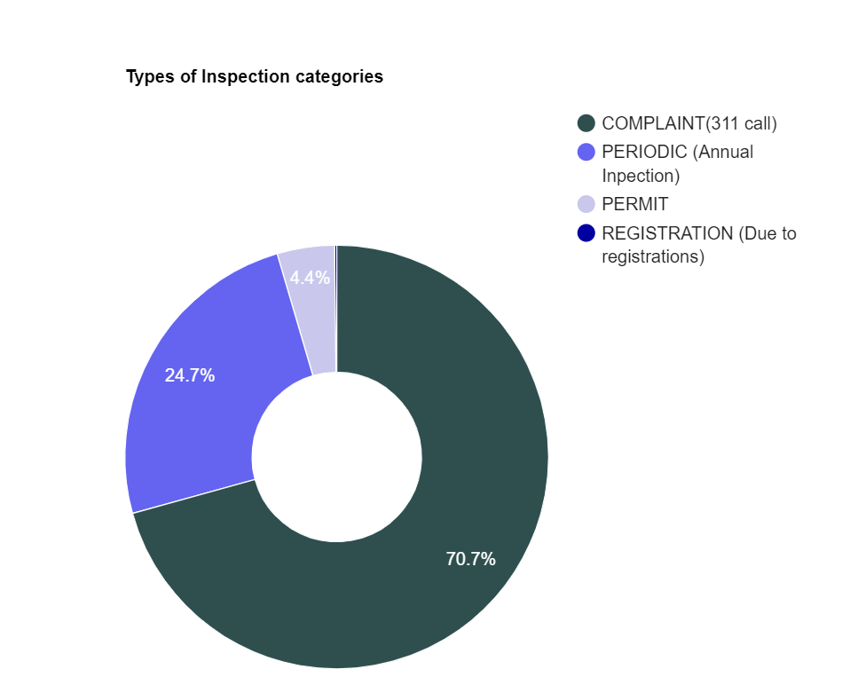
CHICAGO DATA ANALYSIS
Nearly 70% of cases files are through 311 calls followed by followed by annual inspections.

Slide 39
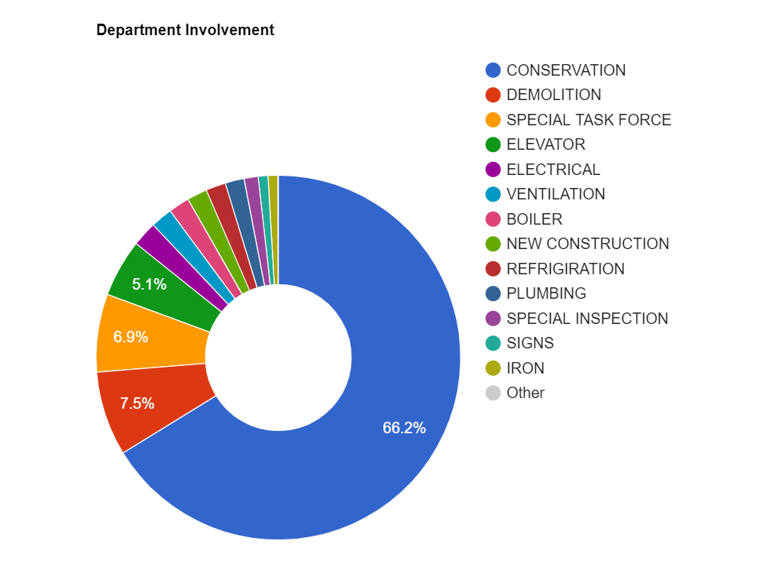
CHICAGO DATA ANALYSIS
This donut chart shows that Conservation department involvement in handling these property violations cases is the most. It is about 66.2%.

Slide 40
Thank You!

